Slide 1
Simple Review
Knapsack Problem
  0/1
Huffman codes
Shortest paths
  Dijkstra’s algorithm

Slide 2
Design and Analysis of Algorithms
Shortest Paths II (Ch24)

Slide 3
Design and Analysis of Algorithms
Shortest Paths II
Topics:
Bellman-Ford algorithm

Slide 4
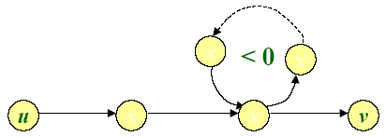
Negative-weight cycles
Recall: If a graph G=(V,E) contains a negative-weight cycle, then some shortest paths may not exist.
Example:
Bellman-Ford algorithm: Finds all shortest-path lengths from a source s∈V to v∈V or determines that negative-weight cycle exists.

Slide 5

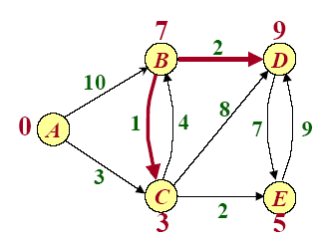
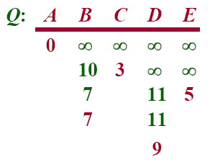

Example of Dijkstra’s algorithm
-8
9

Slide 6
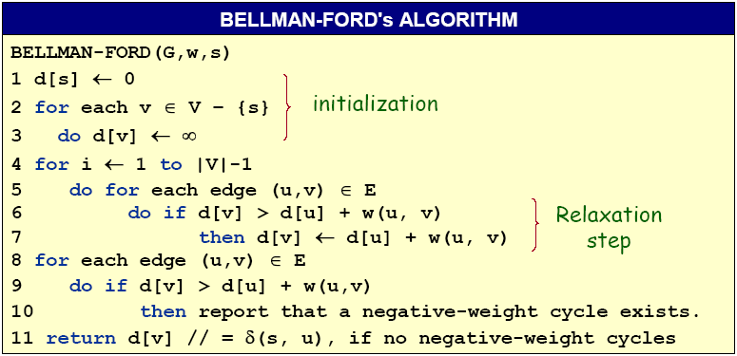
Bellman-Ford algorithm
Time=O(VE)

Slide 7
Example of Bellman-Ford
B
-1
2
3
2
E
A
1
4
-3
C
D
5

Slide 8
Example of Bellman-Ford
∞
B
-1
2
∞
3
2
E
0
A
1
4
-3
C
D
5
∞
∞
Initialization

Slide 9
Example of Bellman-Ford
∞
B
①
-1
2
⑦
③
∞
④
3
2
E
0
A
1
⑧
⑤
4
②
-3
C
⑥
D
5
∞
∞
Order of edge relaxation

Slide 10
Example of Bellman-Ford
∞
B
①
-1
2
⑦
③
∞
④
3
2
E
0
A
1
⑧
⑤
4
②
-3
C
⑥
D
5
∞
∞

Slide 11
Example of Bellman-Ford
∞
B
①
-1
2
⑦
③
∞
④
3
2
E
0
A
1
⑧
⑤
4
②
-3
C
⑥
D
5
∞
∞

Slide 12
Example of Bellman-Ford
∞
B
①
-1
2
⑦
③
∞
④
3
2
E
0
A
1
⑧
⑤
4
②
-3
C
⑥
D
5
∞
∞

Slide 13
Example of Bellman-Ford
∞
B
①
-1
2
⑦
③
∞
④
3
2
E
0
A
1
⑧
⑤
4
②
-3
C
⑥
D
5
∞
∞

Slide 14
Example of Bellman-Ford
-1
B
①
-1
2
⑦
③
∞
④
3
2
E
0
A
1
⑧
⑤
4
②
-3
C
⑥
D
5
∞
∞

Slide 15
Example of Bellman-Ford
-1
B
①
-1
2
⑦
③
∞
④
3
2
E
0
A
1
⑧
⑤
4
②
-3
C
⑥
D
5
∞
∞

Slide 16
Example of Bellman-Ford
-1
B
①
-1
2
⑦
③
∞
④
3
2
E
0
A
1
⑧
⑤
4
②
-3
C
⑥
D
5
4
∞

Slide 17
Example of Bellman-Ford
-1
B
①
-1
2
⑦
③
∞
④
3
2
E
0
A
1
⑧
⑤
4
②
-3
C
⑥
D
5
4
∞

Slide 18
Example of Bellman-Ford
-1
B
①
-1
2
⑦
③
∞
④
3
2
E
0
A
1
⑧
⑤
4
②
-3
C
⑥
D
5
4
∞

Slide 19
Example of Bellman-Ford
-1
B
①
-1
2
⑦
③
∞
④
3
2
E
0
A
1
⑧
⑤
4
②
-3
C
⑥
D
5
2
∞

Slide 20
Example of Bellman-Ford
-1
B
①
-1
2
⑦
③
∞
④
3
2
E
0
A
1
⑧
⑤
4
②
-3
C
⑥
D
5
2
∞

Slide 21
Example of Bellman-Ford
-1
B
①
-1
2
⑦
③
∞
④
3
2
E
0
A
1
⑧
⑤
4
②
-3
C
⑥
D
5
2
∞
End of pass 1

Slide 22
Example of Bellman-Ford
-1
B
①
-1
2
⑦
③
∞
④
3
2
E
0
A
1
⑧
⑤
4
②
-3
C
⑥
D
5
2
∞

Slide 23
Example of Bellman-Ford
-1
B
①
-1
2
⑦
③
1
④
3
2
E
0
A
1
⑧
⑤
4
②
-3
C
⑥
D
5
2
∞

Slide 24
Example of Bellman-Ford
-1
B
①
-1
2
⑦
③
1
④
3
2
E
0
A
1
⑧
⑤
4
②
-3
C
⑥
D
5
2
∞

Slide 25
Example of Bellman-Ford
-1
B
①
-1
2
⑦
③
1
④
3
2
E
0
A
1
⑧
⑤
4
②
-3
C
⑥
D
5
2
∞

Slide 26
Example of Bellman-Ford
-1
B
①
-1
2
⑦
③
1
④
3
2
E
0
A
1
⑧
⑤
4
②
-3
C
⑥
D
5
2
1

Slide 27
Example of Bellman-Ford
-1
B
①
-1
2
⑦
③
1
④
3
2
E
0
A
1
⑧
⑤
4
②
-3
C
⑥
D
5
2
1

Slide 28
Example of Bellman-Ford
-1
B
①
-1
2
⑦
③
1
④
3
2
E
0
A
1
⑧
⑤
4
②
-3
C
⑥
D
5
2
1

Slide 29
Example of Bellman-Ford
-1
B
①
-1
2
⑦
③
1
④
3
2
E
0
A
1
⑧
⑤
4
②
-3
C
⑥
D
5
2
1

Slide 30
Example of Bellman-Ford
-1
B
①
-1
2
⑦
③
1
④
3
2
E
0
A
1
⑧
⑤
4
②
-3
C
⑥
D
5
2
1

Slide 31
Example of Bellman-Ford
-1
B
①
-1
2
⑦
③
1
④
3
2
E
0
A
1
⑧
⑤
4
②
-3
C
⑥
D
5
2
1

Slide 32
Example of Bellman-Ford
-1
B
①
-1
2
⑦
③
1
④
3
2
E
0
A
1
⑧
⑤
4
②
-3
C
⑥
D
5
2
-2

Slide 33
Example of Bellman-Ford
-1
B
①
-1
2
⑦
③
1
④
3
2
E
0
A
1
⑧
⑤
4
②
-3
C
⑥
D
5
2
-2
End of pass 2 (and 3 and 4)

Slide 34
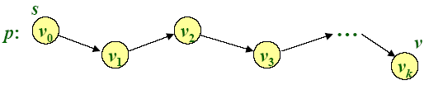
Correctness
Theorem. If G=(V,E) contains no negative-weight cycles, then after the Bellman-Ford algorithm executes, d[v]=δ(s,v) for all v∈V
Proof. Let v ∈V be any vertex, and consider a shortest path p from s to v with the minimum number of edges.
Since p is a shortest path, we have
δ(s,v_{i})=δ(s,v_{i-1})+w(v_{i-1},v_{i})

Slide 35
Correctness (continued)
Initially, d[v₀]=0=δ(s,v₀) and d[v₀] is unchanged by subsequent relaxations (because of the lemma from previous Lecture that d[v] ≥δ(s,v))
-- After 1 path through E, we have d[v₁]= δ(s,v₁)
-- After 2 path through E, we have d[v₂]= δ(s,v₂)
--…
-- After k path through E, we have d[v_{k}]= δ(s,v_{k})
Since G contains no negative-weight cycles, p is simple.
Longest simple path has ≤|V|-1 edges.□

Slide 36
Example of Bellman-Ford
-1
B
①
-1
2
⑦
③
1
④
3
2
E
0
A
1
⑧
⑤
4
②
-3
C
⑥
D
5
2
-2
d[B] must be -1 after pass 1
d[E] must be 1 after pass 2
d[D] must be -2 after pass 3

Slide 37
Detection of negative-weight cycles
Corollary. If a value d[v] fails to converge after |V|-1 passes, there exists a negative-weight cycle in G reachable from s.□
Notes:
converge：收敛

Slide 38
Bellman-Ford algorithm
Time=O(VE)

Slide 39
Homework
24.1-1

